Slide 1
Chapter 3-3
Analog Transmission

Slide 2
Topics
Digital Data-to -Analog Signal
Analog Signal-to-Analog Signal
Multiplexing

Slide 3
Analog transmission
Analog –continuous signal that is having a value at every instance of time.
Analog transmission is the transmission of analog signal over a transmission media.
Digital transmission is very desirable but a low-pass channel with a very large bandwidth is needed.
Analog transmission is the only choice if we have a band-pass channel

Slide 4
Digital-to-Analog Conversion
By changing one characteristic(amplitude, frequency, or phase) of a simple electric signal(analog signal) based on the information in the digital signal(0s or 1s)
Transmitting data from one computer (digital) to another across a public phone line (carrier analog signals) requires that the digital data must be modulated on an analog signal that has been manipulated to loo two distinct values corresponding to binary o and 1
main use is public telephone system
has freq range of 300Hz to 3400Hz
use modem (modulator-demodulator)

Slide 5
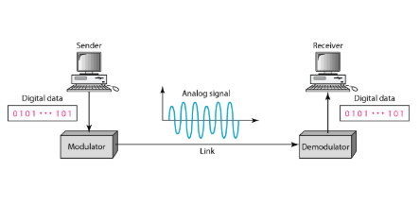
Figure shows the relationship between the digital information, the digital-to-analog modulating process, and the resultant analog signal.

Slide 6
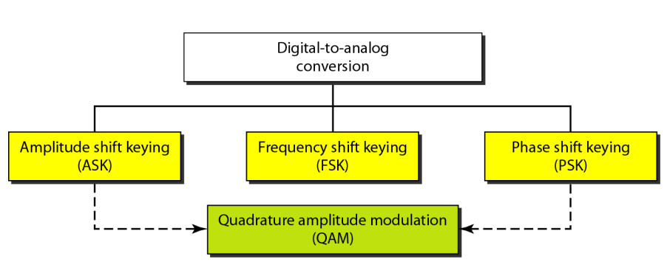
Digital Data, Analog Signal
Notes:
We turn now to the case of transmitting digital data using analog signals. The most familiar use of this transformation is for transmitting digital data through the public telephone network. The telephone network was designed to receive, switch, and transmit analog signals in the voice-frequency range of about 300 to 3400 Hz. It is not at present suitable for handling digital signals from the subscriber locations (although this is beginning to change). Thus digital devices are attached to the network via a modem (modulator-demodulator), which converts digital data to analog signals, and vice versa.
Have stated that modulation involves operation on one or more of the three characteristics of a carrier signal: amplitude, frequency, and phase. Accordingly, there are three basic encoding or modulation techniques for transforming digital data into analog signals, as illustrated in Stallings DCC8e Figure 5.7 (next slide): amplitude shift keying (ASK), frequency shift keying (FSK), and phase shift keying (PSK). In all these cases, the resulting signal occupies a bandwidth centered on the carrier frequency.

Slide 7
Aspects of Digital-to-Analog Conversion
bit
baud rates
carrier signal.

Slide 8
Data Element Versus Signal Element
Data element as the smallest piece of information to be exchanged, the bit.
signal element smallest unit of a signal that is constant.
Data Rate Versus Signal Rate
Bit rate/data rate is the number of bits per second.
Baud rate / signal rate is the number of signal elements per second.
In the transmission of digital data, the baud rate is less than or equal to the bit rate.

Slide 9
A signal unit is composed of one or more bits.
The fewer signal units required, the more efficient the system and less bandwidth required to transmit more bits.
The baud rate determines the bandwidth required to send the signal NOT the number of bits.
In transportation, a baud is analogous to a car, and a bit is analogous to a passenger. A car can carry one or more passengers.
The number of cars not the number of passengers determines the traffic and therefore the need for wider highways.

Slide 10
We can define the data rate (bit rate) and the signal rate (baud rate). The relationship between them is S= N/r baud where N is the data rate (bps) and r is the number of data elements carried in one signal element. The value of r in analog transmission is r =log2^{L}, where L is the type of signal element, not the level.

Slide 11
Carrier Signal
In analog transmission, the sending device produces a high-frequency signal that acts as a base for the information signal.
This base signal is called the carrier signal or carrier frequency.
The receiving device is tuned to the frequency of the carrier signal that it expects from the sender.
Digital information then changes the carrier signal by modifying one or more of its characteristics (amplitude, frequency, or phase).
This kind of modification is called modulation or shift keying and the information signal is called the modulating signal.

Slide 12
Amplitude Shift Keying
The amplitude (height) of the carrier signal is varied to represent binary 0 or 1. Both frequency and phase remain constant while the amplitude changes.
Although we can have several levels (kinds) of signal elements, each with a different amplitude, ASK is normally implemented using only two levels. This is referred to as binary amplitude shift keying or on-off keying (OOK).
The peak amplitude of one signal level is 0; the other is the same as the amplitude of the carrier frequency.

Slide 13
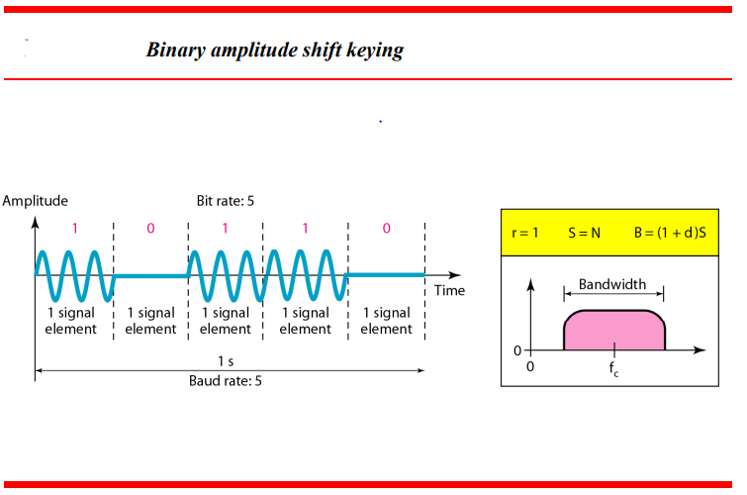

Slide 14
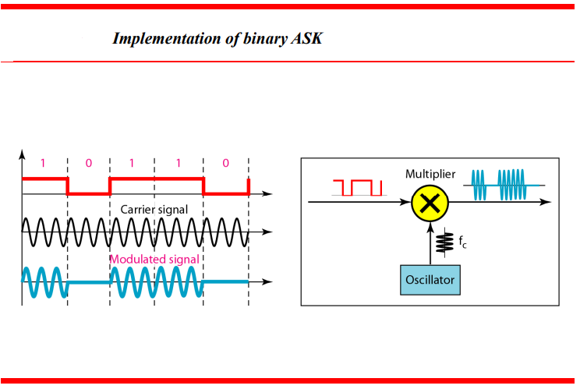

Slide 15
susceptible to noise interference because noise mainly affects amplitude
inefficient
used for
up to 1200bps on voice grade lines
very high speeds over optical fiber

Slide 16
Frequency Shift Keying
In frequency shift keying, the frequency of the carrier signal is varied to represent binary 1 or zero.
The frequency of the modulated signal is constant for the duration of one signal(each bit duration) element, but changes for the next signal element if the data element changes.
Both peak amplitude and phase remain constant for all signal elements

Slide 17
most common is binary FSK (BFSK)
two binary values represented by two different frequencies (near carrier)
less susceptible to error than ASK
used for
up to 1200bps on voice grade lines
high frequency radio
even higher frequency on LANs using co-ax
Notes:
The most common form of FSK is binary FSK (BFSK), in which the two binary values are represented by two different frequencies near the carrier frequency, as shown in Stallings DCC8e Figure 5.7b.
BFSK is less susceptible to error than ASK. On voice-grade lines, it is typically used up to 1200 bps. It is also commonly used for high-frequency (3 to 30 MHz) radio transmission. It can also be used at even higher frequencies on local area networks that use coaxial cable.

Slide 18
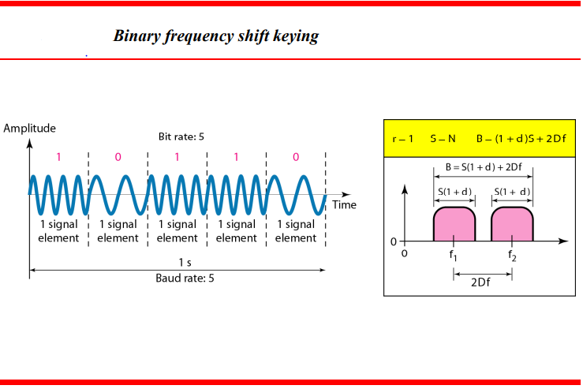

Slide 19
Multiple FSK
each signalling element represents more than one bit
more than two frequencies used
more bandwidth efficient
more prone to error
Notes:
A signal that is more bandwidth efficient, but also more susceptible to error, is multiple FSK (MFSK), in which more than two frequencies are used. In this case each signaling element represents more than one bit. To match the data rate of the input bit stream, each output signal element is held for a period of T_{s} = LT seconds, where T is the bit period (data rate = 1/T). Thus, one signal element, which is a constant-frequency tone, encodes L bits. The total bandwidth required is 2Mf_{d}. It can be shown that the minimum frequency separation required is 2f_{d} = 1/T_{s}. Therefore, the modulator requires a bandwidth of W_{d} = 2Mf_{d} = M/T_{s}.

Slide 20
Phase Shift Keying
The phase of the carrier is varied to represent to represent binary 1 or 0.
The phase of the signal during each bit duration is constant, and its value depends on the bit (0 or 1).
Both peak amplitude and frequency remain constant as the phase changes.
Today, PSK is more common than ASK or FSK.
The simplest PSK is binary PSK, in which we have only two signal elements, one with a phase of 0°, and the other with a phase of 180° to represent the two binary digits.

Slide 21
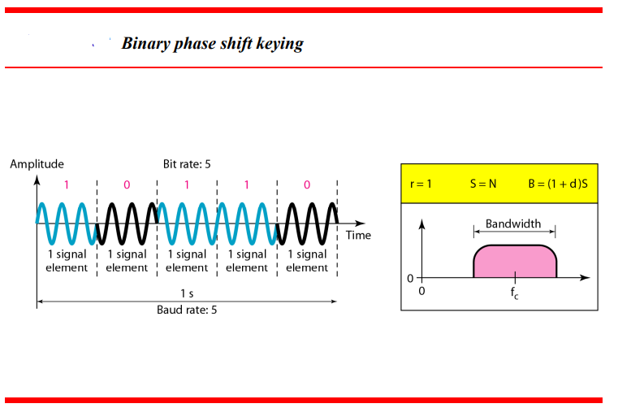

Slide 22
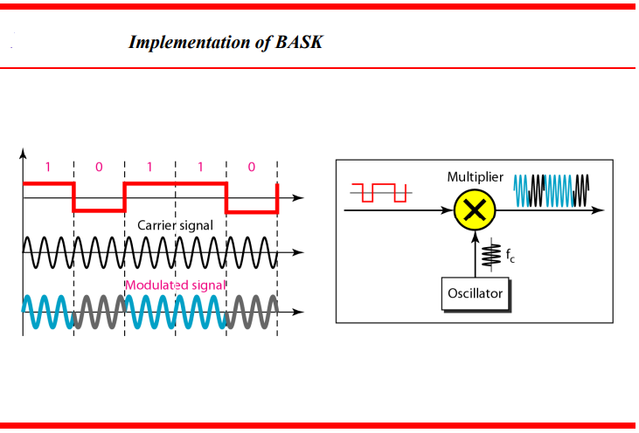

Slide 23
A constellation or phase-state diagram shows the relationship between phase and bit value.
PSK is not susceptible to the noise degradation that affects ASK or to the bandwidth limitations of FSK.
Therefore, we can use four variations of a signal, each representing 2 bits. This technique is called 4-PSK or Q-PSK. The pair of bits represented by each phase is called a dibit.
Notes:
In PSK, the phase of the carrier signal is shifted to represent data. The simplest scheme uses two phases to represent the two binary digits (Figure 5.7c) and is known as binary phase shift keying.
An alternative form of two-level PSK is differential PSK (DPSK). In this scheme, a binary 0 is represented by sending a signal burst of the same phase as the previous signal burst sent. A binary 1 is represented by sending a signal burst of opposite phase to the preceding one. This term differential refers to the fact that the phase shift is with reference to the previous bit transmitted rather than to some constant reference signal. In differential encoding, the information to be transmitted is represented in terms of the changes between successive data symbols rather than the signal elements themselves. DPSK avoids the requirement for an accurate local oscillator phase at the receiver that is matched with the transmitter. As long as the preceding phase is received correctly, the phase reference is accurate.

Slide 24
The 4-PSK idea can be extended to 8-PSK. Instead of 90° , we can vary the signal by shifts of 45°.
With eight different phases, each shift can represent 3 bits (a tribit).
The minimum bandwidth required for PSK transmission is the same as that required for ASK transmission (for the same reasons).
While the maximum baud rates of ASK and PSK are the same for a given bandwidth, PSK bit rates using the same bandwidth can be 2 or more times greater.

Slide 25
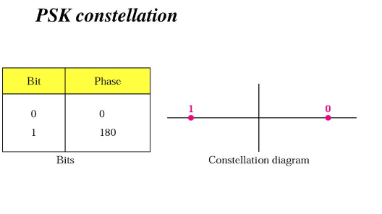

Slide 26
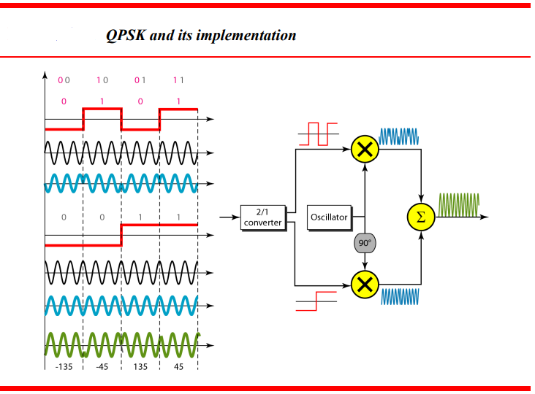

Slide 27
Quadrature Amplitude Modulation (QAM)
PSK is limited by the ability of the equipment to distinguish small differences in phase.
So far we have been altering only one of the three characteristics of a sine wave at a time. What if we alter two?
Bandwidth limitations make combinations of FSK with other changes practically useless.
As such, we will combine ASK with PSK.

Slide 28
If we have x variations in phase and y variation in amplitude, we will have x*y possible variations. This is called Quadrature Amplitude Modulation (QAM).
Possible variations of QAM are numerous.
To avoid noise interference, QAM always uses more phase shifts than amplitude shifts.

Slide 29
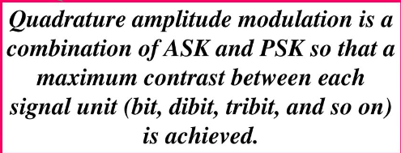

Slide 30
Analog-to- Analog conversion
Analog-to-analog conversion, or analog modulation, is the representation of analog information by an analog signal. →modulate carrier frequency with analog data
One may ask why we need to modulate an analog signal, it is already analog?
Modulation is needed if the medium is bandpass in nature or if only a bandpass channel is available to us. modulate carrier frequency with analog data
An example is radio. The government assigns a narrow bandwidth to each radio station.
The analog signal produced by each station is a low-pass signal, all in the same range.
To be able to listen to different stations, the low-pass signals need to be shifted, each to a different range.
Analog-to-analog conversion can be accomplished in three ways: AM, FM and PM.
Notes:
Analog data can be modulated by a carrier frequency to produce an analog signal in a different frequency band, which can be utilized on an analog transmission system. The basic techniques are amplitude modulation (AM), frequency modulation (FM), and phase modulation (PM).
Modulation has been defined as the process of combining an input signal m(t) and a carrier at frequency f_{c} to produce a signal s(t) whose bandwidth is (usually) centered on f_{c}. For digital data, the motivation for modulation should be clear: When only analog transmission facilities are available, modulation is required to convert the digital data to analog form. The motivation when the data are already analog is less clear. After all, voice signals are transmitted over telephone lines at their original spectrum (referred to as baseband transmission). There are two principal reasons for analog modulation of analog signals:
A higher frequency may be needed for effective transmission, since for unguided transmission, it is virtually impossible to transmit baseband signals;
Modulation permits frequency division multiplexing, an important technique explored in Chapter 8.
In this section we look at the principal techniques for modulation using analog data: amplitude modulation (AM), frequency modulation (FM), and phase modulation (PM). As before, the three basic characteristics of a signal are used for modulation.

Slide 31
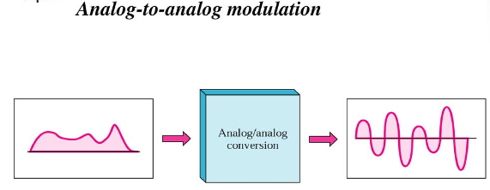

Slide 32
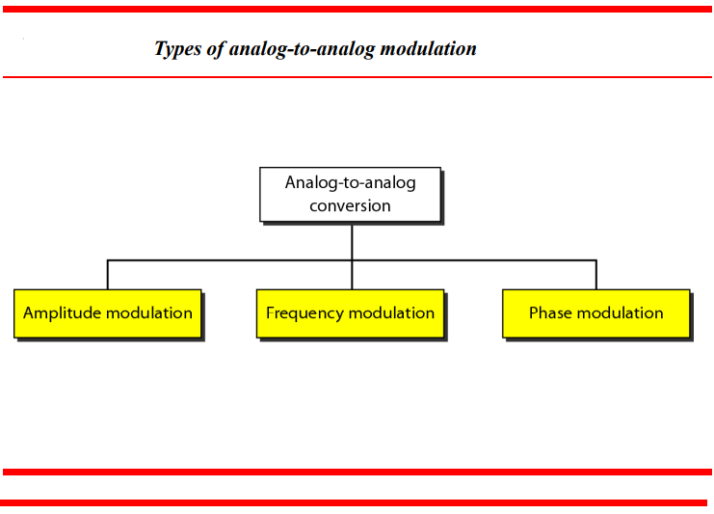

Slide 33
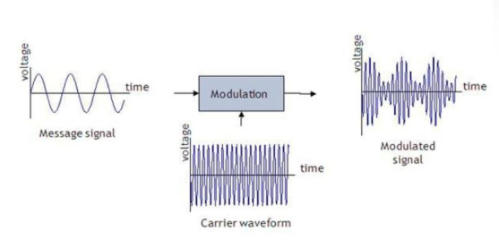

Slide 34
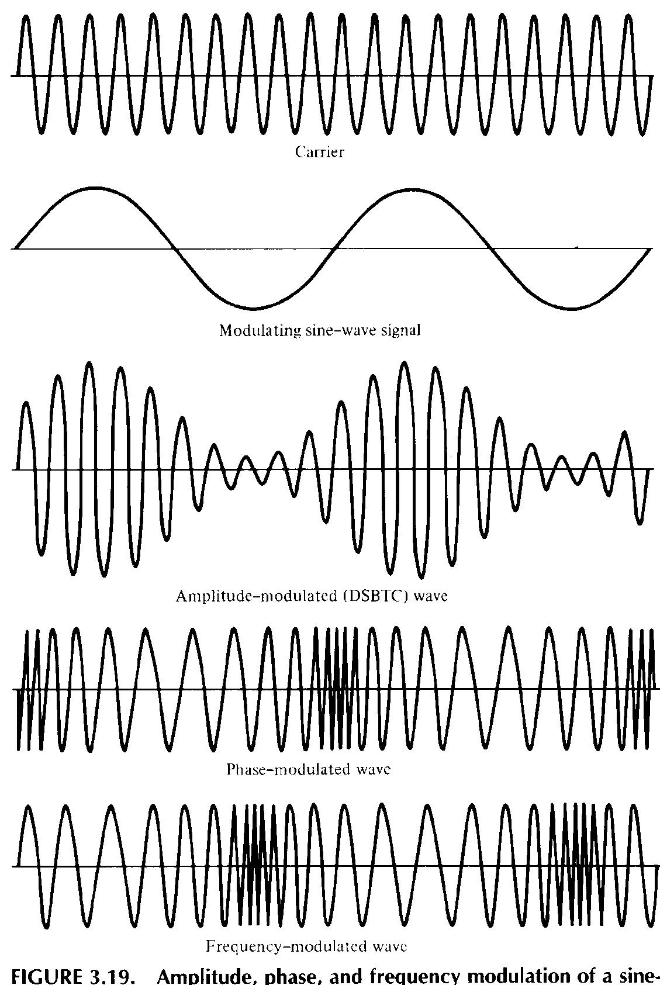
Analog Modulation Techniques
Amplitude Modulation
Frequency Modulation
Phase Modulation
Notes:
Amplitude modulation (AM) is the simplest form of modulation, and involves the multiplication of the input signal by the carrier f_{c}. The spectrum consists of the original carrier plus the spectrum of the input signal translated to f_{c}. The portion of the spectrum for |f| > |f_{c}| is the upper sideband, and the portion of the spectrum for |f| < |f_{c}| is lower sideband. Both the upper and lower sidebands are replicas of the original spectrum M(f), with the lower sideband being frequency reversed. A popular variant of AM, known as single sideband (SSB), takes advantage of this fact by sending only one of the sidebands, eliminating the other sideband and the carrier.
Frequency modulation (FM) and phase modulation (PM) are special cases of angle modulation. For phase modulation, the phase is proportional to the modulating signal. For frequency modulation, the derivative of the phase is proportional to the modulating signal. As with AM, both FM and PM result in a signal whose bandwidth is centered at f_{c}, but can show that the magnitude of that bandwidth is very different, hence both FM and PM require greater bandwidth than AM.
Stallings DCC8e Figure 5.24 illustrates these various techniques showing amplitude, phase, and frequency modulation by a sine wave. The shapes of the FM and PM signals are very similar. Indeed, it is impossible to tell them apart without knowledge of the modulation function.

Slide 35
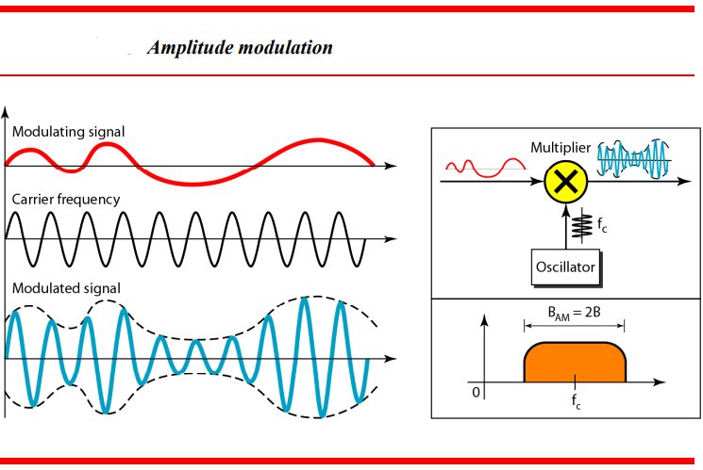

Slide 36
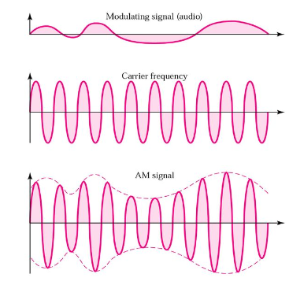

Slide 37
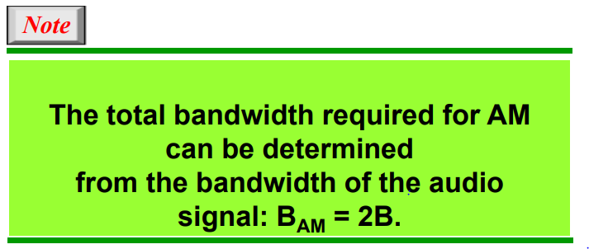

Slide 38
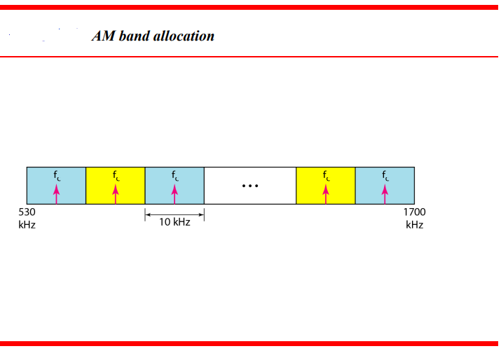

Slide 39
Frequency Modulation (FM)
Frequency Modulation (FM) In FM transmission, the frequency of the carrier signal is modulated to follow the changing voltage level (amplitude) of the modulating signal. The peak amplitude and phase of the carrier signal remains constant.
The bandwidth of an FM signal is 10 times the bandwidth of the modulating signal.
The bandwidth of an audio signal (speech and music) broadcast in stereo is almost 15KHz. Each FM station needs therefore a bandwidth of 150KHz.
The FCC allows 200 KHz for each station to provide some room for guard bands.

Slide 40
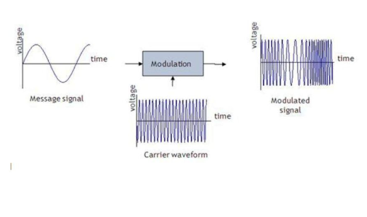

Slide 41
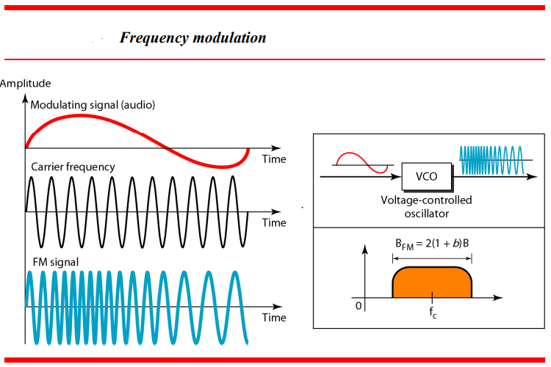

Slide 42
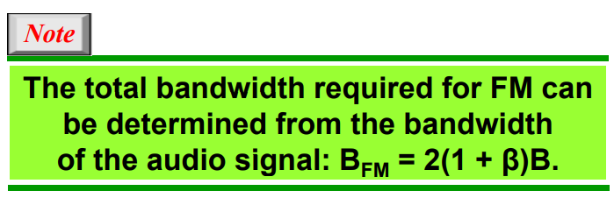

Slide 43
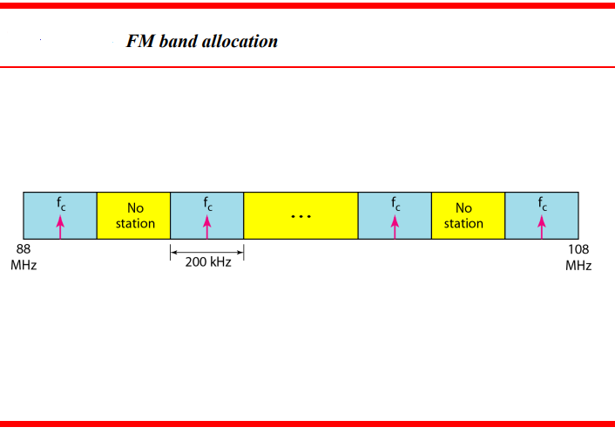

Slide 44
Phase Modulation (PM)
Due to simpler hardware, PM is used in some systems as an alternative to FM.
In PM transmission, the phase of the carrier signal is modulated to follow the changing voltage level (amplitude) of the modulating signal. The peak amplitude and frequency of the carrier signal remain constant.
The analysis and final result (modulated signal) are similar to those of frequency modulation

Slide 45
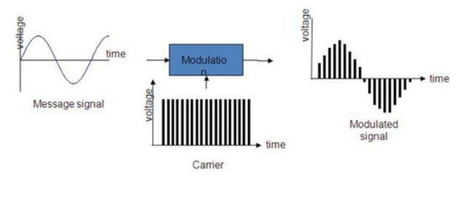

Slide 46
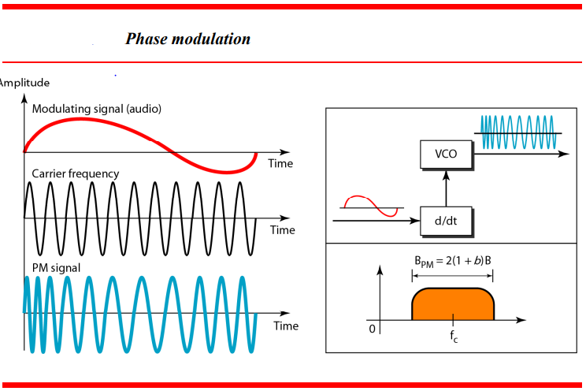

Slide 47
